Slide 1
RNAseq analysis -it’s complicated
March 2017

Slide 2
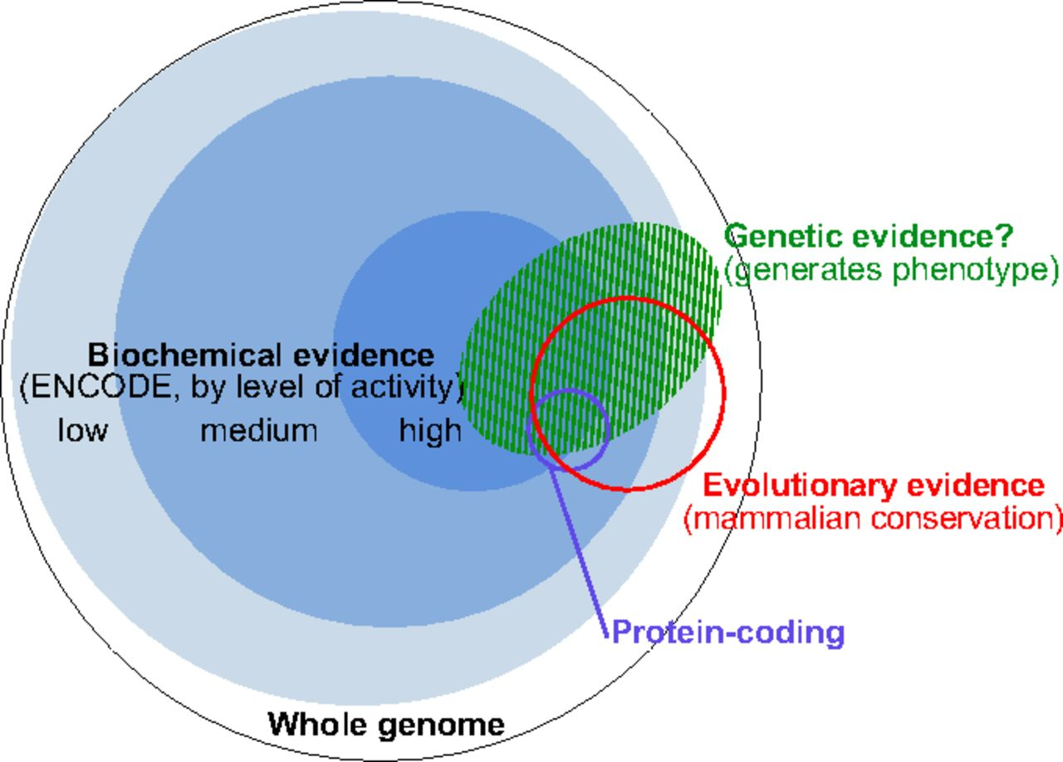
RNA reads are not enough to identify functional RNAs
Defining functional DNA elements in the human genome
Kellis M et al. PNAS 2014;111:6131-6138
Notes:
The complementary nature of evolutionary, biochemical, and genetic evidence. The outer circle represents the human genome. Blue discs represent DNA sequences acted upon biochemically and partitioned by their levels of signal [combined 10th percentiles of different ENCODE data types for high, combined 50th percentiles for medium, and all significant signals for low (see Reconciling Genetic, Evolutionary, and Biochemical Estimates and Fig. 2)]. The red circle represents, at the same scale, DNA with signatures of evolutionary constraint (GERP++ elements derived from 34mammal alignments). Overlaps among the sequences having biochemical and evolutionarily evidence were computed in this work (Fig. 3 and SI Methods). The small purple circle represents protein-coding nucleotides (Gencode). The green shaded domain conceptually represents DNA that produces a phenotype upon alteration, although we lack well-developed summary estimates for the amount of genetic evidence and its relationship with the other types. This summary of our understanding in early 2014 will likely evolve substantially with more data and more refined experimental and analytical methods.

Slide 3
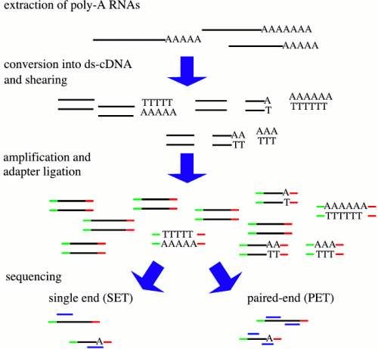
Depending on the steps from sample to RNA seq will give different results
RNA->
AAAAAAAA
PolyA (mRNA)
RiboMinus (- rRNA)
Size <50 nt (miRNA )
…..
enrichments ->
Size of fragment
Strand specific
5’ end specific
3’ end specific
…..
library ->
reads ->
Single end (1 read per fragment)
Paired end (2 reads per fragment)

Slide 4
Mapping (Pär Engström)
Use RNA specific mapper
Use a two-pass workflow
STAR or HISAT
For long (PacBio) reads, STAR, BLAT or GMAP can be used

Slide 5
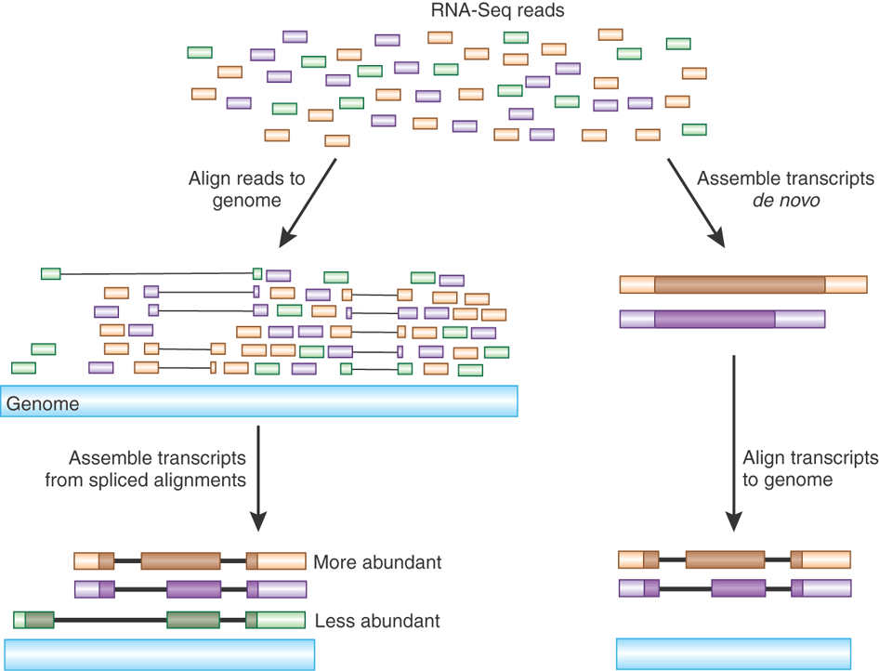
Gene and Isoform detection

Slide 6
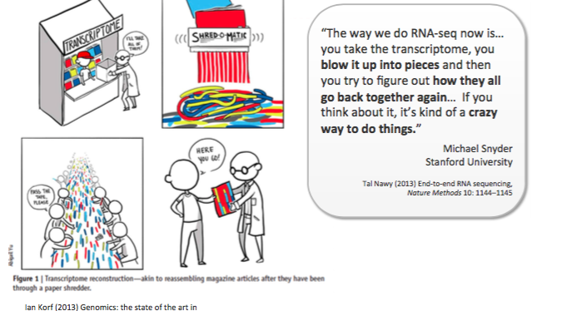
Long reads might be the way to go

Slide 7
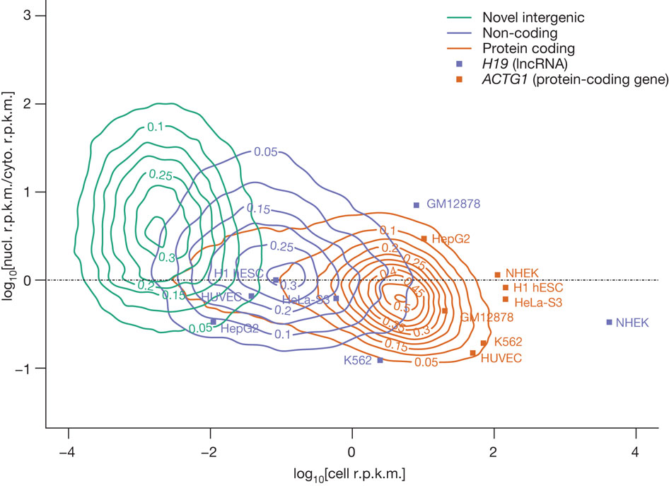
Promises and pitfalls
Long reads
Low throughput (-)
Complete transcripts (++)
Not quantitative (-)
Only highly expressed genes (-)
Expensive (-)
Low background noise (+)
Easy downstream analysis (++)
short reads
High throughput (++)
Quantitative (++)
Fractions of transcripts (-)
Full dynamic range (+-)
Unlimited dynamic range (+)
Cheap (+)
Low background noise (+)
Strand specificity (+)
Re-sequencing (+)

Slide 8
RNA-seq analysis workflow

Slide 9
Do a lot of QC

Slide 10
More variation when using top hat 2 with default settings than when using STAR or Stampy with default setting
C.grandiflora
C.rubella
hybrid
C.grandiflora

Slide 11
RNA QC

Slide 12
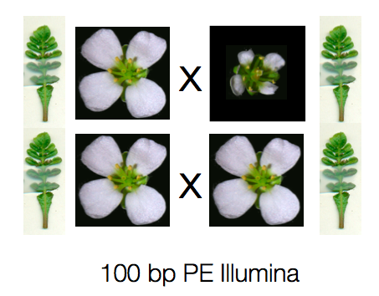
Principal component 1 separates samples from flowers and leaves
C. rubella

Slide 13
Principal component 2 and 3 separates the different species
C. rubella
C. rubella
hybrid
C. grandiflora

Slide 14
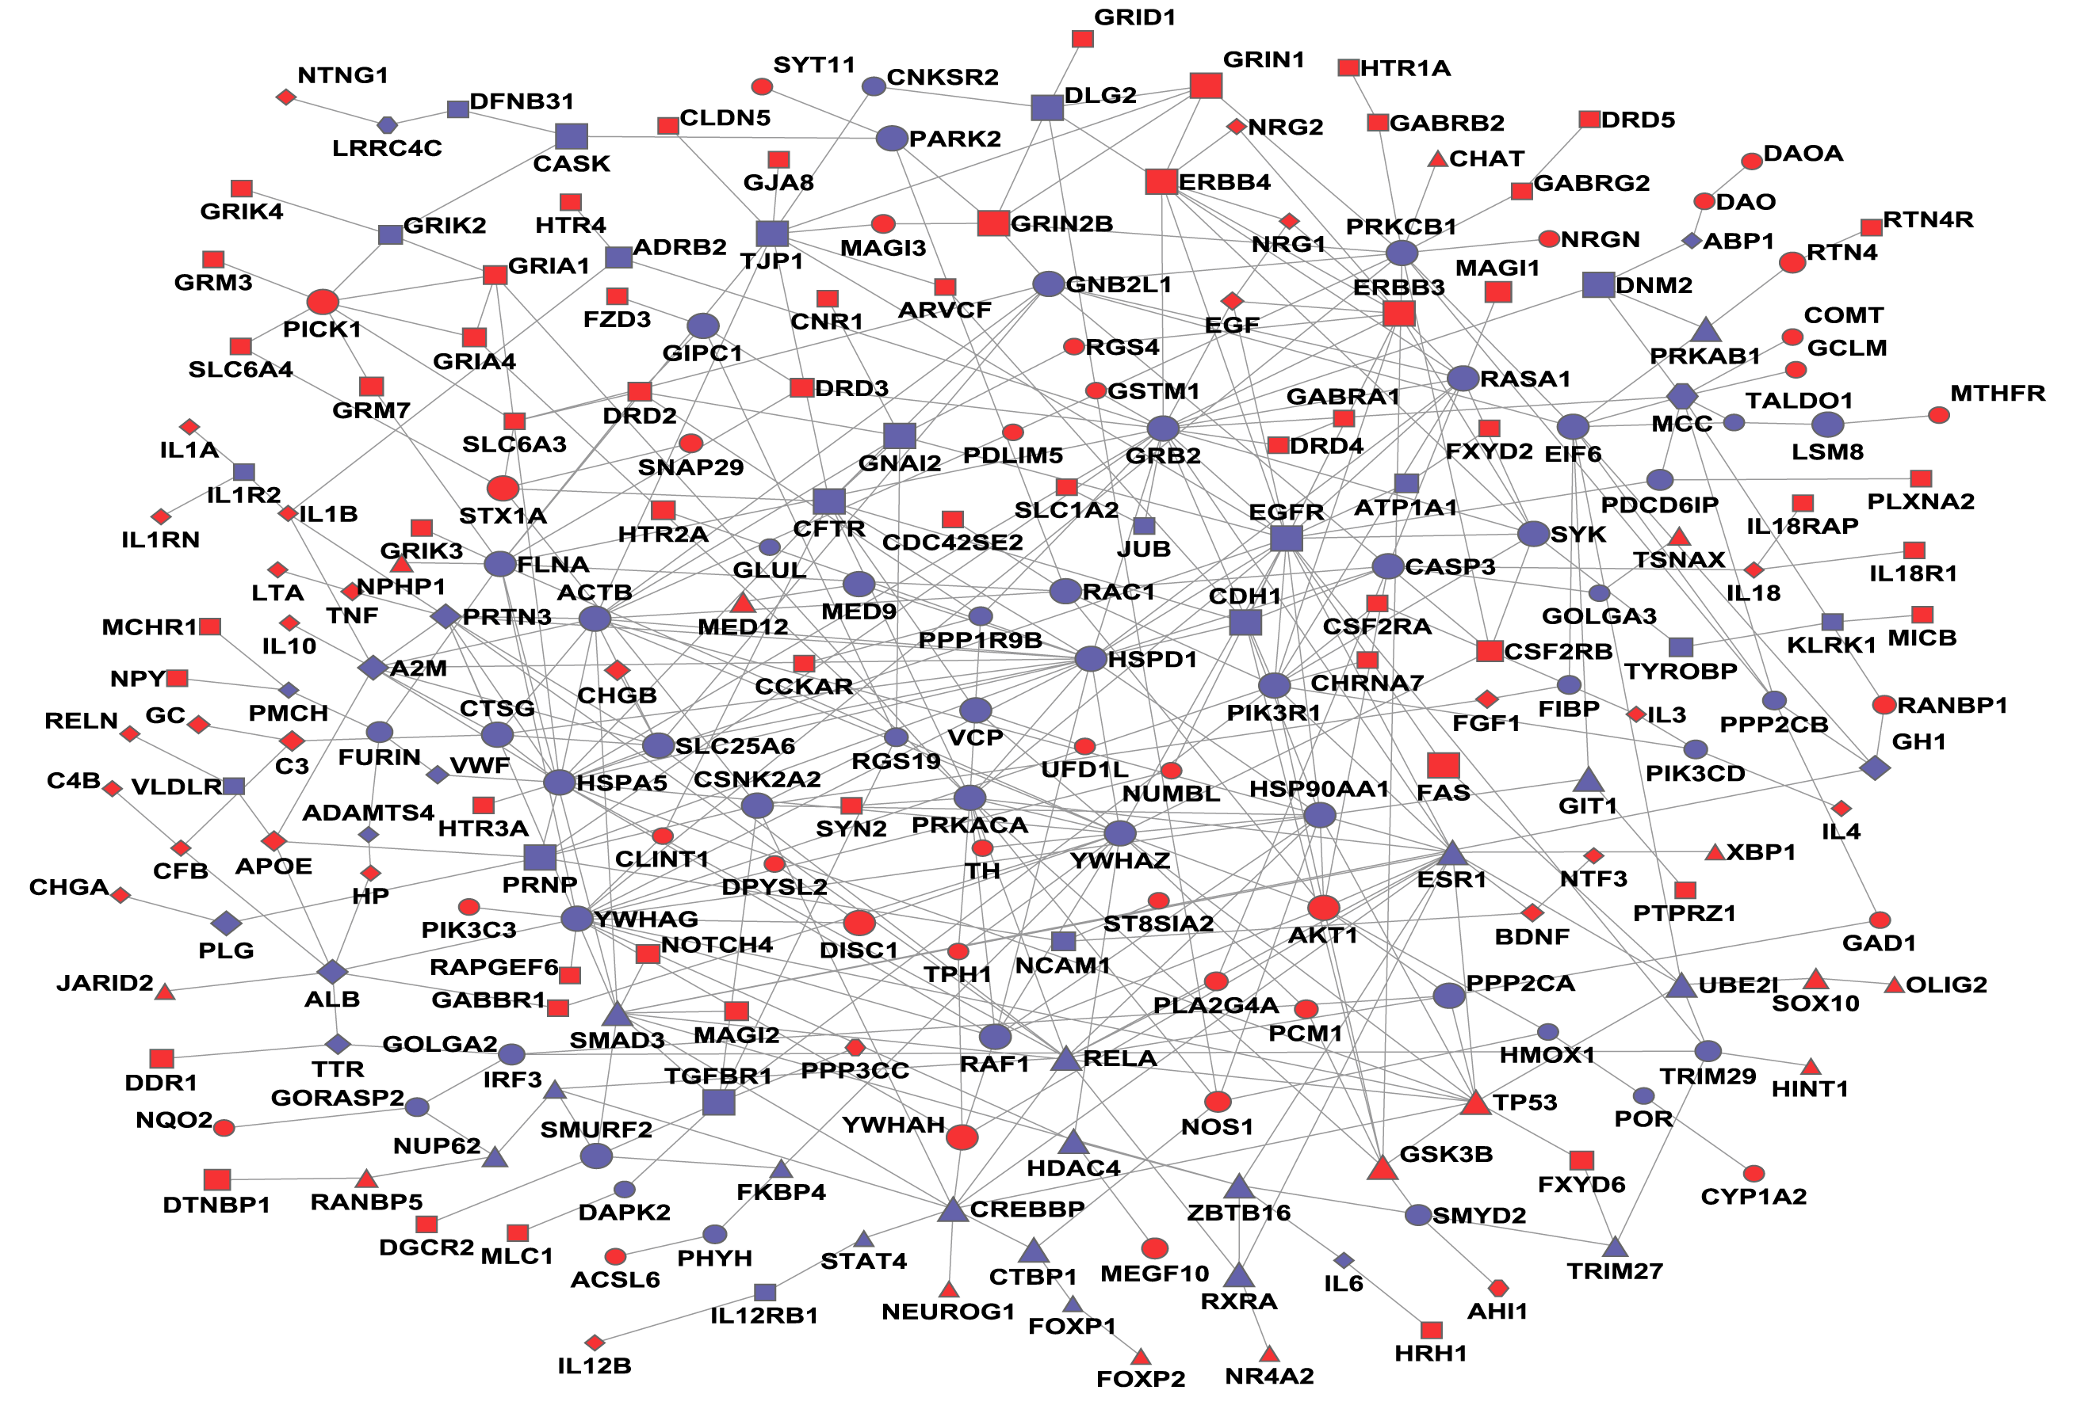
Differential expression analysis Mikael Huss
The identification of genes (or other types of genomic features, such as transcripts or exons) that are expressed in significantly different quantities in distinct groups of samples, be it biological conditions (drug-treated vs. controls), diseased vs. healthy individuals, different tissues, different stages of development, or something else.
Typically univariate analysis (one gene at a time) – even though we know that genes are not independent

Slide 15
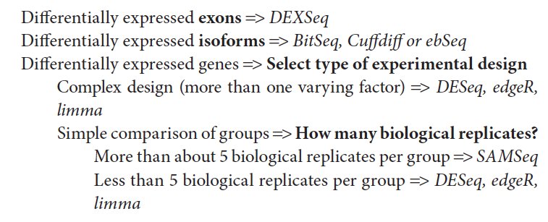
Decision tree for software selection (2016)
Sleuth
, Sleuth
?

Slide 16
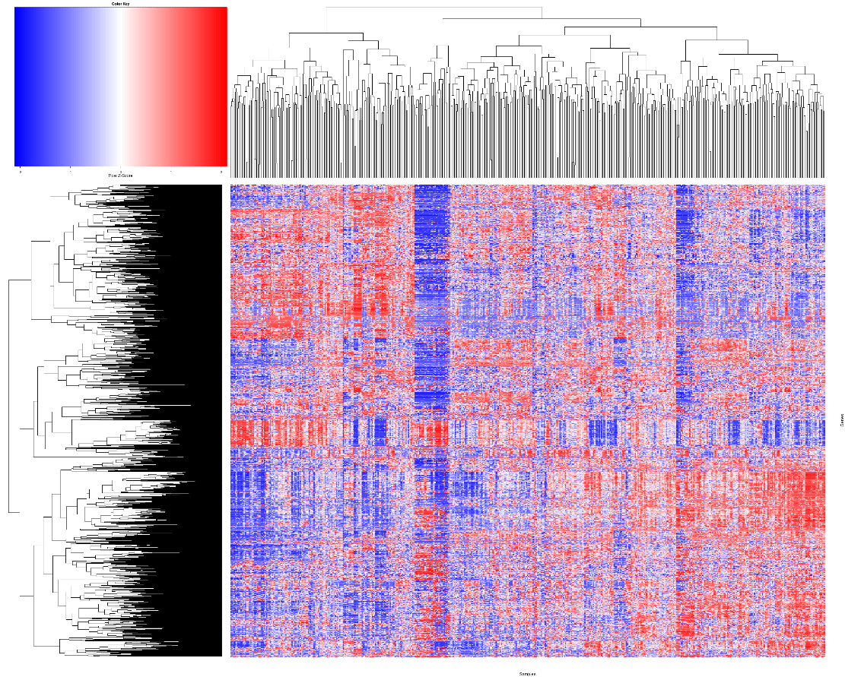

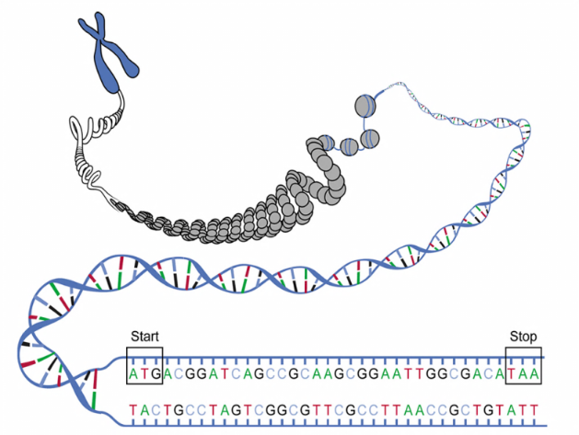
Gene-set analysis (GSA)
Samples
Immune response
Genes
Pyruvate
PPARG
GO-terms
Pathways
Chromosomal locations
Transcription factors
Histone modifications
Diseases
etc…
Gene-set analysis
Gene-level data
Gene-set data (results)
We will focus on transcriptomics and differential expression analysis
However, GSA can in principle be used on all types of genome-wide data.
Notes:
End at 6-7 min

Slide 17
Analysis regarding Type II Diabetes

Slide 18
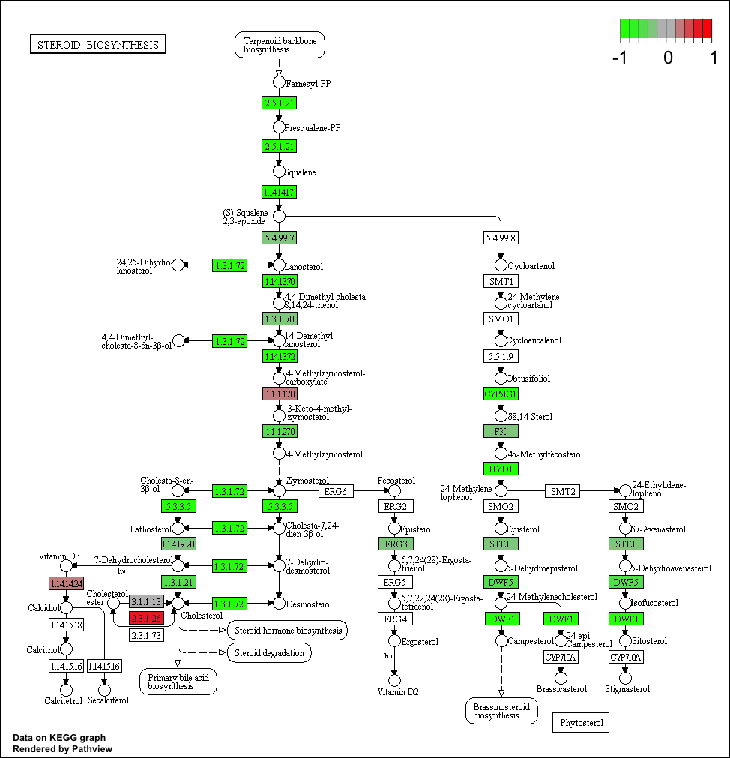
Expression of genes on pathway

Slide 19
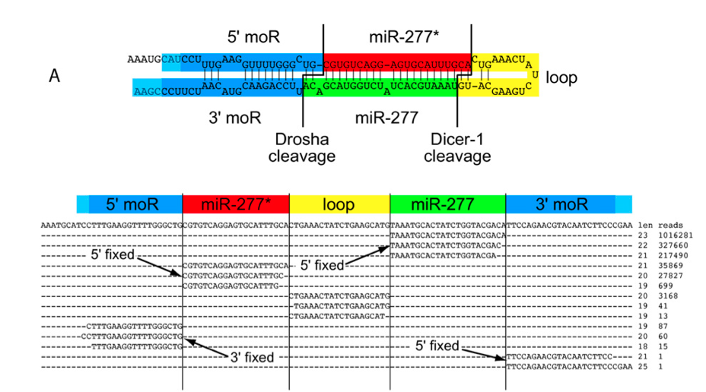
miRNA seq analysis
(Berezikov et al. Genome Research, 2011.)
Notes:
Fixed 5’ ends of miRs
Variable 3’ ends – trimming, tailing

Slide 20
Single cell sequencing

Slide 21
Exercises
Mapping
STAR
HISAT2
Tutorial for reference guided assembly
Cufflinks
Stringtie
Tutorial for de novo assembly
Trinity
Visualise mapped reads and assembled transcripts on reference
IGV
RNA quality controll
Tutorial for RNA seq Quality Control
Differential expression analysis
DEseq2
Calisto and Sleuth
multi variate analysis in SIMCA
small RNA analysis
miRNA analysis
Introductory
Introduction to the RNA seq data provided
Short introduction to R
Short introduction to IGV
Beta labs
Single cell RNA PCA and clustering
Gene set analysis
UPPMAX
sbatch script example

Slide 22
Need help??
We are here for you. Apply for help.

